Slide 1

Cache Design
Part 2 of 2
Line Replacement Policy
Write Policy
Impact on Performance
©Paul Davies. Not to be copied, used, or revised without explicit written permission from the copyright owner.
This lecture may contain animations and is best viewed as a slide show

Slide 2
Review: The Need for CPU Caches
Last lecture we looked at cache operation from a CPU read perspective and several different kinds of cache architecture.
Direct Mapped (easy, but large cache memory size required for good results)
Fully Associative (excellent results with small cache memory, but complex)
Set Associative (good compromise used by most processors)
In today's lecture we will look at cache replacement algorithms and cache write policies.

Slide 3

CPU Address Bus
A 4-Way Set associative Cache:4 Sets x 32 Lines x 8 Words = 2 K Bytes
Shows data loaded from address 08000000 – 0800000F and 098F0000 – 098F000F
Compare with Direct Mapped Solution (page 22) where a clash/eviction would occur.
31 30 29 . . . . . 9
8 . . . . 4
3 2 1
Tag Address
Index
Word
23
5
Block 0
Block 1
Block 2
Block 3
Index
0
1
2
. . . . . . . . .
. . .
29 30 31
V
Tag
Data
V
Tag
Data
Tag
Data
V
Tag
Data
1
0x08000₀₀₀
1
0x098F0₀₀₀
0
0
0
0
0
0
0
0
0
0
0
0
0
0
0
0
0
0
0
0
0
0
0
0
0
0
0
0
0
0
0
0
0
0
0
0
0
0
=
=
=
=
Tag
Hit [0]
Hit [1]
Hit [2]
Hit [3]
D0
D1
D2
D3
Hit[0..3]
4 Way 16 bit Mux
16
Here’s where our discussion ended last lecture
CPU Data

Slide 4
Cache Line Replacement Policies
When new data is needed by the CPU and all blocks in the cache that could store that data are full, a line from a block will have to be replaced. This means evicting the data from a block to create space for the new data.
A cache replacement policy describes the algorithm used to select the block whose line will be evicted.
For DIRECT mapped caches, the choice of “victim” is easy, since there is only one block and any new data always maps, by virtue of the CPU’s address to exactly one line in that block, so we always know which line to evict/replace.
For a 4 way SET associative caches, choices have to be made. A CPU’s address still defines which line in the cache to use but given there are 4 potential blocks whose lines could hold that new data, the cache controller now has to choose which block to select/evict.

Slide 5
Common eviction algorithms include:-
Least recently used (evict the line that has not been used for longest time)
good but costly , have to maintain “age” bits to track usage of lines in blocks.
Least frequently accessed
very good but costly – “access history” has to be tracked for each line all blocks.
Random
simple but poor – a random number generator selects the block with the line to evict.
Round Robin
similar to Random, but just uses a counter
FIFO
Simple, but poor – maintain history of when data was loaded and evict oldest one there with no regard to how often it has been accessed since it was loaded
Some algorithms are better/easier to implement than others, but generally the more complex the algorithm, the better it performs.
For example the last 3 above perform poorly because they do not consider the “usage” of the data. If data is used a lot and/or accessed recently, then it is likely to be used again in the near future, so we should try to avoid evicting it.
See https://en.wikipedia.org/wiki/Cache_replacement_policies

Slide 6
Good Eviction Algorithms Least Recently Used (LRU)

Slide 7
Most caches implement a variation of the least recently used algorithm. The access sequence below shows an initially empty 4-way set associative cache. Imagine the CPU now accesses items of data in the order A B C D A C E D F which for this example we assume map to the same line in each block, gradually filling up the blocks until replacement becomes necessary. Blocks with lowest age will be evicted when required.
CPU Reads A
A[0]
Miss on A: Load A into empty Block[0] : Set A’s Age = 0
CPU Reads B
A[0]
B[1]
Miss on B: Load B into empty Block[1] : Set B’s Age = 1
CPU Reads C
A[0]
B[1]
C[2]
Miss on C: Load C into empty Block[2] : Set C’s Age = 2
CPU Reads D
A[0]
B[1]
C[2]
D[3]
Miss on D: Load D into empty Block[3] : Set D’s Age = 3
Lines full. New miss will have to evict
CPU Reads A
A[5]
B[1]
C[2]
D[3]
Hit on A: Set A’s Age = 5. LRU is B
CPU Reads C
A[5]
B[1]
C[6]
D[3]
Hit on C: Set C’s Age = 6. LRU is B
CPU Reads E
A[5]
E[7]
C[6]
D[3]
Miss on E: Evict B, Load E (Block[1]) and set Age to 7. LRU is D
CPU Reads D
A[5]
E[7]
C[6]
D[8]
Hit on D: Set D’s Age = 8. LRU is A
CPU Reads F
F[9]
E[7]
C[6]
D[8]
Miss on F: Evict A, Load F (Block[0]) and set Age to 9. LRU is C

Slide 8
Implementation
True LRU is expensive, if it is to be done quickly (e.g. in 1 clock cycle).
One solution might be to use an additional 64 age bits per Line plus a 64 bit age counter and an age comparator to find LRU block. It also needs a complex state machine for the cache controller.
Operation
With each access, the age counter for that line is incremented.
When new data is loaded, the block/line’s age bits are set to the value of the counter.
The example below shows one line of a 4 – way set associative cache where the CPU has read data in the order ABCD (as per previous slide.). Note the ages in each line.
Block 0
Block 3
Age Counter
V
Tag
Age
Data
V
Tag
Age
Data
3
1
0
A
1
0
1
0
D
1
3
4 way comparator
LRU
Block with lowest age is selected

Slide 9
Tree Based Pseudo Least Recently Used
(PLRU)
https://en.wikipedia.org/wiki/Pseudo-LRU

Slide 10
Here, the individual line age bits used with true LRU are replaced by shared LRU bits which record a state identifying the line least recently used. This gives a cheaper and simpler implementation which is almost as good and is used in many real cache controllers.
For an N-way set associative design, N-1 state bits are required (e.g. 2 way requires 1 LRU bit)
4 blocks in a line sharing common LRU bits
32 Bit CPU Address Bus
31 30 . . . . . . 9
8 . . . 4
3 2 1
Block 3 Write Signals (from State machine)
Tag Address
Index
Word
Block 0 Write Signals (from State machine)
Block 1 Write Signals (from State machine)
Block 2 Write Signals (from State machine)
23
5
V
Block 0
V
Block 1
Block 2
V
Block 3
LRU Bits
Index
0
1
2
. . . . . . 29 30 31
Tag
Data
Tag
Data
Tag
Data
Tag
Data
000
0
0
0
0
000
0
0
0
0
000
0
0
0
0
000
0
0
0
0
000
0
0
0
0
000
0
0
0
0
000
0
0
0
0
000
0
0
0
0
000
0
0
0
0
000
0
0
0
0
=
=
=
=
Tag
V [0]
Hit [0]
V [1]
Hit [1]
V [2]
Hit [2]
V [3]
Hit [3]
D0
D1
D2
D3
Hit [0..3]
4 Way 16 bit Mux
16
CPU Data

Slide 11
Example: 2 –way set associative cache (1 LRU bit required)
Think of the single LRU bit as pointing to one of 2 leaf nodes in a tree.
If LRU bit = 0, we assume the node/line on the left is the one least recently used
If LRU bit = 1, the node/line on the right is the one least recently used
With each read or write of that line, we simply flip the value of LRU bit to point away from the most recently used (just accessed) block (towards the new least recently used block).
Imagine reading data in this order: AABAC
Block 0 is least recently used
0
1
Block 1 is least recently used
1
Block 1 is still least recently used
?
?
A
?
A
?
Read ‘A’: Miss, evict Block 0
Read ‘A’: Hit
Read ‘B’: Miss, evict Block 1
Block 0 is least recently used
0
1
Block 1 is least recently used
Block 0 is least recently used
0
A
B
A
B
A
C
Read ‘A’: Hit, point to Block 1
Read ‘C’: Miss, evict Block 1

Slide 12
For a 4 way set associative cache, 3 LRU bits are needed, assume initially = {000}.
After a read or write, the LRU bits that “pointed” to that block are similarly reversed. again to prevent early eviction of an item of data just recently used.
Imagine reading data in this order: ABCDEC
LRU is Block 0
Bit 0
0
LRU is Block 2
1
LRU is Block 1
0
Bits 1 & 2
0
0
1
0
1
1
(1)
(2)
(3)
4 Blocks
A
A
B
Read ‘A’: Miss, evict Block 0 and load with A
Read ‘B’: Miss, evict Block 2 and load with B
Read ‘C’: Miss, evict Block 1 and load with C
LRU is Block 3
1
LRU is Block 0
0
LRU is Block 2
1
0
1
0
0
1
0
(4)
(5)
(6)
A
C
B
A
C
B
D
E
C
B
D
Read ‘D’: Miss, evict Block 3 and load with D
Read ‘E’: Miss, evict Block 0
and load with E
Read ‘C’: Hit Block 2 still LRU

Slide 13
Summary of LRU updates in Tabular form for easy implementation in Verilog
LRU[0] = 0?
Let a ‘0’ represent that data on the left hand side of a tree branch has been accessed less recently than the right hand side. For example [xx0] means LRU data is somewhere on the left main branch. [1x0] means the LRU data is on the left sub-branch of the right main branch.
Yes
No
LRU[1] = 0?
LRU[2] = 0?
Yes
No
Yes
No
Block 0
Block 1
Block 2
Block 3
Line LRU State Bits [2..0] | Replace data in this block
x00 | Block 0
x10 | Block 1
0x1 | Block 2
1x1 | Block 3
‘x’ means don’t care because its value does not affect the chosen branch
If a read or write (load) access to a line in this block occurs | Set LRU State Bits [2..0] for the line to
Block 0 | _11
Block 1 | _01
Block 2 | 1_0
Block 3 | 0_0
 | ‘_’ means leave the bit unchanged because it was not part of the path that was leading to the just accessed data

Slide 14
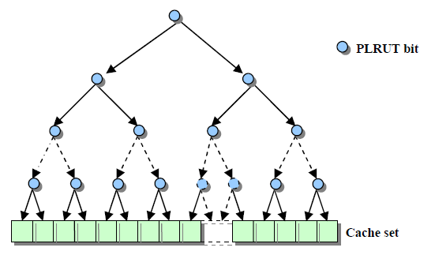
Illustration of a 16 Way Set associative cache with 15 LRU bits.
Question: Can you work out the order that the blocks of an empty cache are filled.
Results show PLRU has ~1-5% worse performance than pure LRU but savings are large.
15 LRU bits
16 blocks/line

Slide 15
Cache Write Policy

Slide 16
Cache Writing Policy
When the CPU writes data we must ensure that one way or another the data eventually gets written to main memory. Whether we also write that data to the cache depends upon our cache write policy.
Some of these have implications for Multi-Core Systems.
There are four policies commonly used:
Write Through
Write Back (also called Write Behind)
Write Allocate
Write Around

Slide 17
Write Through Caches

Slide 18
With a write through cache, CPU Data (let’s assume a simple integer variable ‘i’) is written to the Cache and Dram at the same time.
‘i’ in dram is thus always up-to-date and coherent with cache.
Downside is High Dram Traffic, i.e. a write to Dram every time ‘i’ changes.
CPU read of 'i' only results in a read from dram if cache does have a copy.
CPU 1
i ++ ;
Cache 1 i = 100
Dram
i = 100
‘i’ written to Cache by CPU
Cache writes ‘i’ to dram whenever ‘i’ changes

Slide 19
Write Back Caches

Slide 20
If the data is already in the cache, the new data (‘i’) is written only to the cache (fast).
‘i’ is only updated in main memory when the cache line is evicted/flushed.
Results in lower Dram Traffic.
If ‘i’ is not in the cache, bypass the cache and write data directly to memory.
This could happen for example at the start of a program when initialising ‘i’ to say 5, or if ‘i’ has been evicted and replaced by another variable in the cache.
Any future read of ‘i’ would bring that data into cache at that time (filling a line).
CPU 1
i ++ ;
Cache i = 100
Dram
i = 0
‘i’ read from and written to Cache by CPU
Data written to Dram only when data evicted from cache
CPU 1
i = 5 ;
Cache (‘i’ not present)
Dram
i = 5
Data write bypasses cache

Slide 21
Write-back caches require a single “dirty” bit per block to mark data as “changed”.
An added complication of this approach is that any future miss reading another variable may mean that the dirty data has to be evicted/written to dram before being replaced.
Tag Address
Index
Word
23
5
3
Tag
Index
Index + Word
+
Dirty
Valid
Tag Data
8
Cached Data: 8 words per Line
Index
0
1
2
. . . . . . . . .
. . .
29 30 31
0
0
0
0
0
0
0
0
0
0
32 Cache Lines of 8 Words
0
0
0
0
0
0
0
0
0
0
Tag In
Tag Out
=
16
CPU Data
“Dirty” bits, 1 per line
Hit

Slide 22
Write Allocate Caches

Slide 23
Write - Allocate Caches
If the data being written is NOT in the cache, most common approach is to:-
Write the data to memory first (slow, results in dram traffic)
Then perform a read to bring the written data back into the cache along with data close to it, to take advantage of spatial locality and to fill a complete line.
Maintains consistency between Cache and main memory
If data is NOT in cache
CPU 1
i = 5 ;
Dram
i = 5
1) Data written to Dram Immediately
Cache 1 i = 5
2) Read data back into cache along with nearby by data to fill a line

Slide 24
However, if the data being written is already in the cache then the cache is updated and main memory is updated either immediately or “lazily” when the data is evicted.
If data is in cache (i.e. write hit)
CPU 1
i ++ ;
Cache 1 i = 100
Dram
i = 100
CPU writes ‘i' to cache
Data written to Dram
Immediately or
Upon eviction

Slide 25
Write Around Caches

Slide 26
Write Around Caching
Here, the write bypasses the cache and always writes data to main memory.
If the data was already in the cache, that line will simply be invalidated forcing it to be read next time it is needed.
Slower – can lead to lots of dram traffic depending upon program.
CPU 1
i ++ ;
Dram
i = 100
1) Data written only to Dram bypassing cache completely
Cache 1 <invalidate>
2) If data was in cache, then invalidate that data

Slide 27
Rational for Using Write Around policy
Reading or writing variables from/to main memory typically accounts for < 10% of all dram accesses.
Perhaps only 10% of those accesses involve writing a variable, so the penalty in terms of performance for not caching written data will generally be quite small.
This scheme is also very attractive in unified caches (shared data/instruction) where writing a variable to the cache might cause a whole line of instructions to be evicted leading to poor performance.
It also means that when writing the data to memory, only the variable itself (perhaps a byte) needs to be written rather than a whole line, speeding up the write.
This write policy will be used with our soft core 68k i.e. it will also use a unified cache (shared data and instruction).

Slide 28
Cache Performance

Slide 29
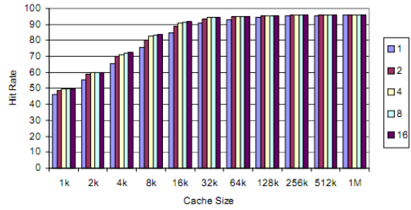
The graph below shows how both cache size and associativity affects “hit” rate for a physically LARGE benchmark program, i.e. the whole program is too big to fit inside the cache. Results are shown for ‘n’ = 1 (a direct mapped cache) to ‘n’ = 16, a 16 way set associative cache). You can see the performance variation between 1 and 16 way diminishes as the total size of the cache increases. This is to be expected as more of any given program will reside in the cache at any point in time, increasing the hit rate.
The sweet spot seems to be a 4 – way set associative design. The advantages of going 8 or 16 way are tiny and are offset by more complex design (but it’s your choice).

Slide 30
Other factors that can affect cache performance
See graph over page
Small Line Size (i.e. # of bytes/words per cache line)
Poor performance because they do not take maximum advantage of spatial locality, i.e. the idea that data close to the current access will be needed soon.
Large Line Size
Interestingly Miss rates increase with lines that are too large. This is because more data has to be evicted (written to dram) to make room for any new data. This is especially noticeable for small caches with large lines.
In addition, the more data brought in, the further away the extremities of that data are from the CPU’s current access and the less likely it is that such data will be used before being evicted. That is, we might waste time bringing in data that may never be accessed – it’s always a trade of.
Sweet Spot
Approximately 32/64 bytes per line for a medium sized cache.

Slide 31
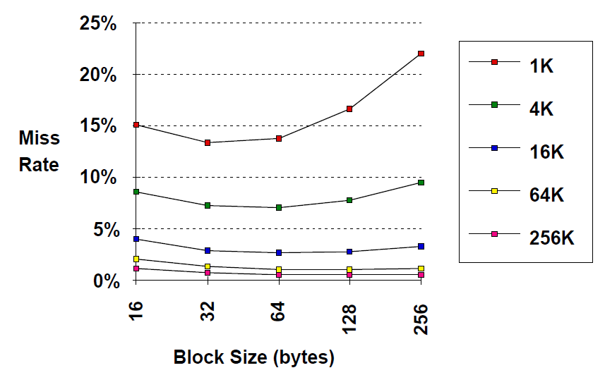
Impact of Line size on Cache Miss Rate
Line Size (Bytes)

Slide 32
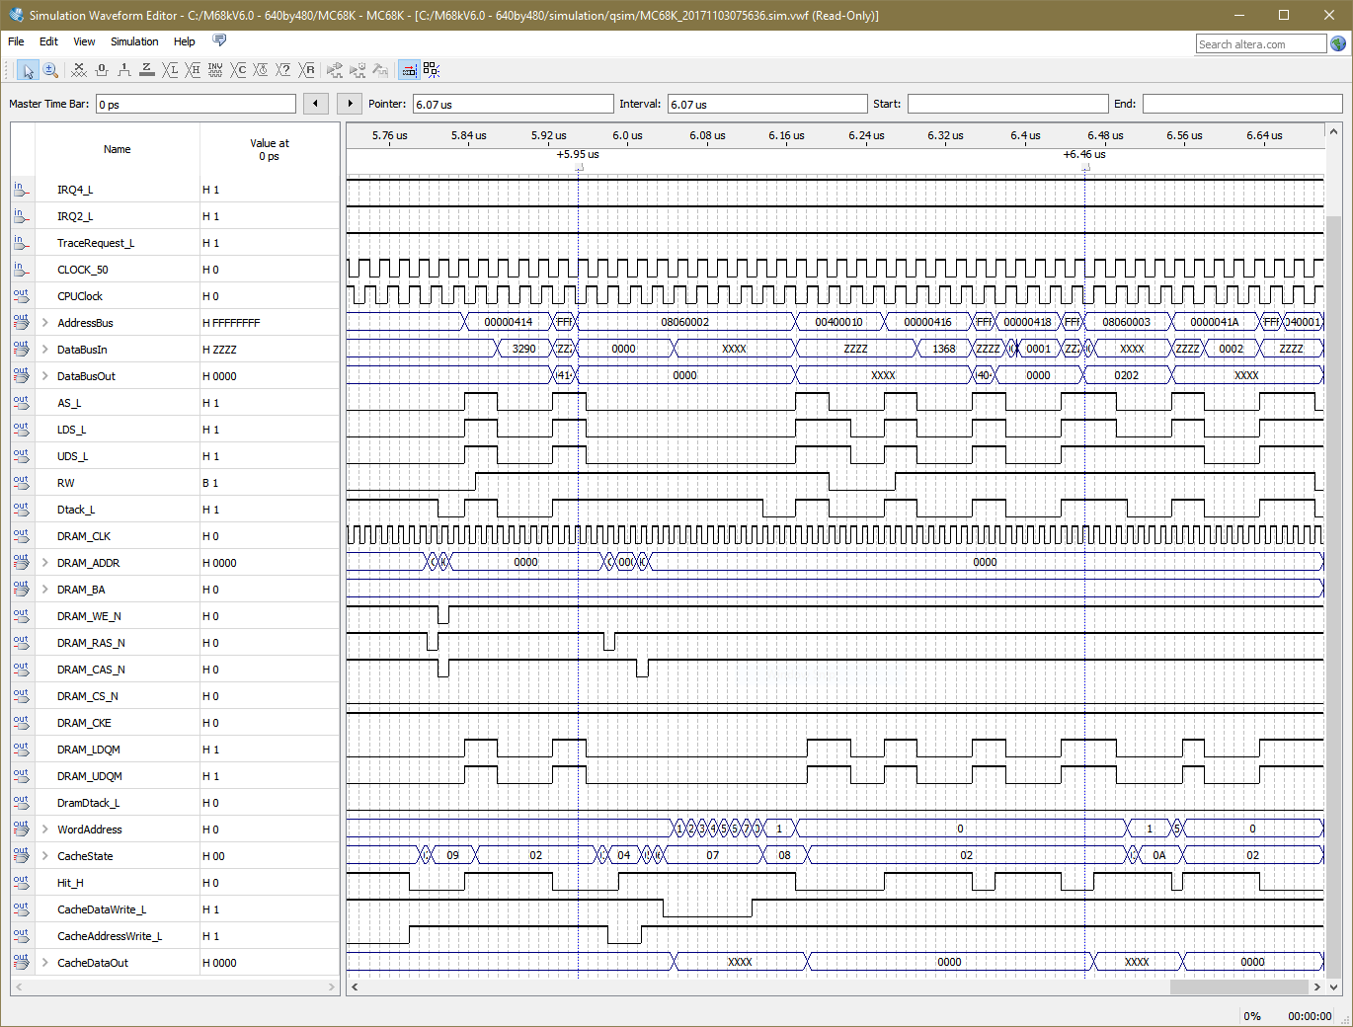
Quartus Simulation of 68k read showing Dram burst read to fill a cache line
68k attempts to read a Word from 0x08060002, it generates a MISS and the access time is 10 CPU clocks from AS_L.
Byte Read from 0x08060003, generates a HIT, just 4 CPU clocks.
Dram Read on Miss
No Dram Read on Hit
Burst read of 8 words 0 - 7
Word 1 given to CPU
Miss
Hit

Slide 33
Question
How do cache hits and misses affect overall system performance, using our 68k as an example?
Assuming a hit access time of 4 CPU clock cycles (i.e. no delays), program execution will continue normally on a cache hit with no wait states.
For a cache miss our CPU must wait for a “burst fill” from main memory into a line of the cache. Assuming a burst length of 8 words per line, as per last slide, this takes 10 CPU clock cycles.
Simple Example Analysis of Cache Performance
Imagine we have a 25Mhz 68k running a program with 1000 instructions directly from Dram i.e. no cache and no wait states. The situation we had at the end of assignment 2.
Assuming 4 clocks per dram access that’s 4000 clock periods to run the whole program. We’ll Ignore writes to Dram – just to get an impression of the impact that cache size, and read miss rate has on execution performance.

Slide 34
What if we had a small cache with a 75% hit rate
Here, just 3 out of 4 of our 1000 instruction fetches result in a hit.
Execution time = 750 (4) + 250 (10) = 5500 clocks.
Relative performance is therefore = 4000/5500 = 0.727 i.e. slower
However, having the cache allows us to increase the CPU clock speed from 25 to 45Mhz i.e. a factor of 1.8 and performance at 45Mhz will be (1.8 * 0.727) = 1.31
That is, our 45Mhz CPU will perform like a 32.7Mhz processor with no wait states.
What if our cache was larger with a 95% hit rate while running this program
With a 95% hit rate, execution time = 950 (4) + 50 (10) = 4300 clocks.
Relative performance is therefore = 4000/4300 = 0.93.
Again the cache allows us to raise CPU clock speed from 25 to 45Mhz i.e. by factor of 1.8 and performance at 45Mhz will be (1.8 * 0.93) = 1.67.
That is, our 45Mhz CPU will perform like a 41.75Mhz processor with no wait states.

Slide 35
What if our cache still had a 95% hit rate but we raised the CPU clock speed to 1Ghz and kept the same slow Dram. Now we have a 400 clock “miss” penalty (not 10)
With a 95% hit rate, execution time = 950 (4) + 50 (400) = 23,800 clocks.
Relative performance is therefore = 4000/23800 = 0.168.
Raise clock speed from 25 to 1Ghz i.e. by factor of 40 and performance of new CPU will be (40 * 0.168) = 6.72.
That is, our 1Ghz will perform like a 168 MHz processor with no wait states.
You can see that even with a relatively low MISS rate, a main memory access can have a huge impact on the performance of a very fast CPU.
If our cache had a 75% hit rate with the same 1Ghz and 400 clock “miss” penalty
With a 75% hit rate, execution time = 750 (4) + 250 (400) = 103,000 clocks.
Relative performance is therefore = 4000/103000 = 0.039.
Raise clock speed from 25 to 1Ghz i.e. by factor of 40 and performance of new CPU will be (40 * 0.039) = 1.56.
That is, our 1Ghz will perform like a 39MHz processor with no wait states.
Cache designers aim for 99% hit rates, often with 3 large levels of cache to soften the blow of a miss from a level 1 cache. The last thing you want is to go out to dram for data.

